Slide 1
Portfolio Presentation
By Mark Conanan

Slide 2
Design Process
The website aesthetic is aimed to be simple and dynamic
Portfolio is designed to be on one page, with the initial screen having an animation to get the attention of viewers.
Different fonts were used to emphasize text content (Montserrat, Lato and Libre Baskille)
A sticky header and footer/nav bar is used with the body margins to provide a frame on the page.
All pictures are sourced from unsplash.com.

Slide 3
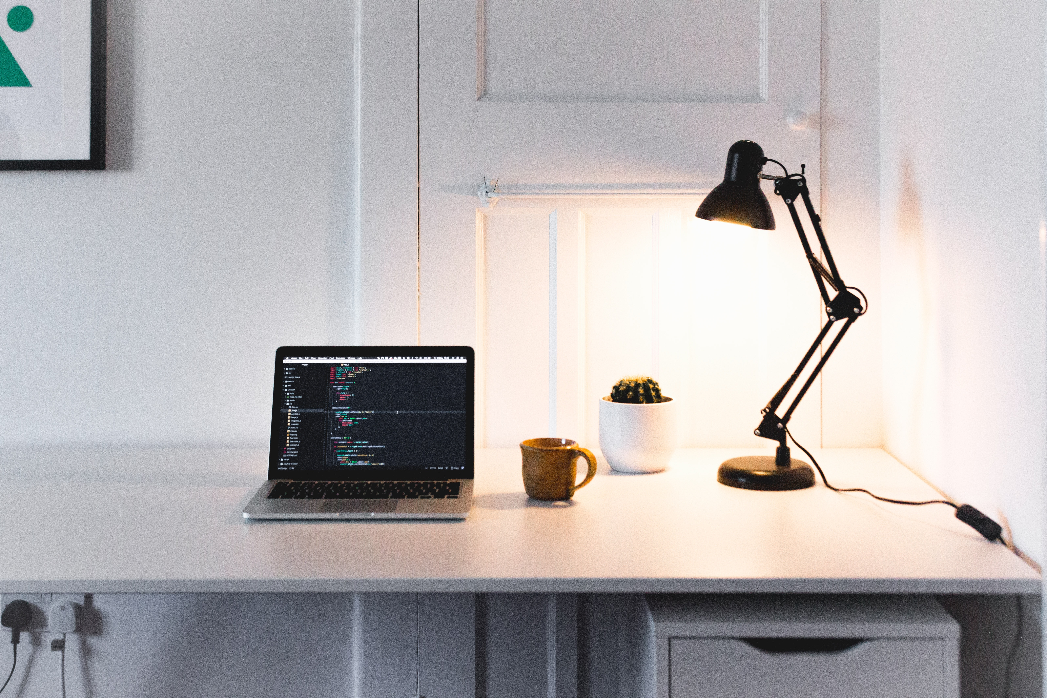

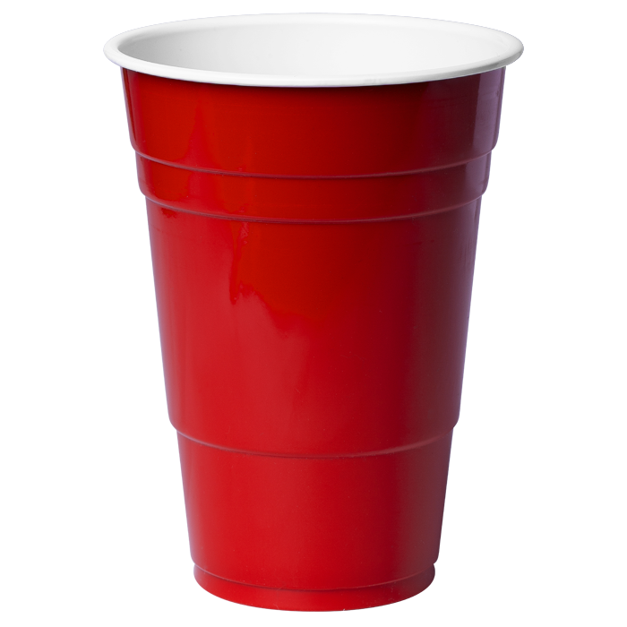
Mood Board

Slide 4
Live Demo

Slide 5
Build Process and Challenges
Code everything in one go and modify
Became a challenge in itself as modifying breaks a lot in the code
Lesson - code and debug each part before continuing with the next
Positioning the texts in the Divs
Parallax Backgrounds
Flexbox and Grid

Slide 6
Ethics and Favorite Parts
All pictures are sourced from unsplash.com (no copyright infringement)
Design and execution
Working code

